Slide 2
Channels:
The Next Evolution of Dataflow
Matt Surridge CLA
Application Engineering Specialist
National Instruments
Notes:
Channels (formerly known to some as Asynchronous Wires) are now available as a first-class feature in LabVIEW 2016.
This is a brief description of the history and philosophy behind channels and a quick tour of how to use them.

Slide 3
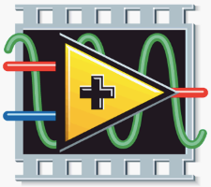
The Vision Driving LabVIEW
Reduce Artificial Complexity
Tool for Scientists & Engineers
as productive as
Spreadsheet for Financial Analysts
Notes:
The philosophy we have always had for developing LabVIEW can be summarized in a simple phrase: *reduce artificial complexity.
A task has inherent complexity due to its nature, and artificial complexity due to the tools you have to use. More powerful tools reduce the artificial complexity and therefore the overall complexity of a task.
Our original goal was to: *make a tool for scientists and engineers that would be as productive as the spreadsheet was for financial analysts.
*We succeeded by inventing LabVIEW with its graphical structured data-flow programming language, and we have been fleshing out its capabilities ever since.

Slide 4
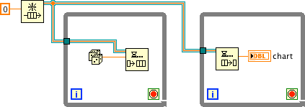
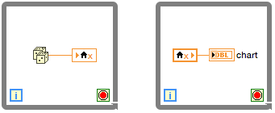
The Evolution of G: Channels
Communicate Between Parallel Loops
Notes:
One capability we knew wasn’t addressed well at the start was the ability to *communicate between parallel loops.
Over the years we introduced a variety of ways to accomplish this using stateful subVIs, globals, references, and *queue references. But none of these were really satisfactory because they didn’t visually show the *flow of data.
A decade ago I experimented with what I called “asynchronous wires” at the time (and Dr. T called “Jeff’s wire”!) and now this capability is available in LabVIEW 2016 under the much more descriptive name of Channels.

Slide 5
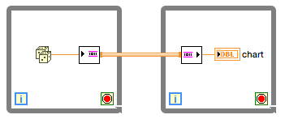
Channels
Write
Endpoint
Channel
Connection
Read
Endpoint
Notes:
Compared to previous state of the art in LabVIEW, Channels greatly reduce the artificial complexity of communication between parallel loops.
*The communication is much easier to understand because Channels visually represent the by-value flow of data, and abstract details of synchronization, initialization, shutdown, and cleanup.
*A Channel is distinguished from a regular wire by its drawing style, invisible tunnels, and flanges at subVI calls (suggestive of a pipe or pneumatic tube). The difference is subtle but easily recognizable with use.

Slide 6
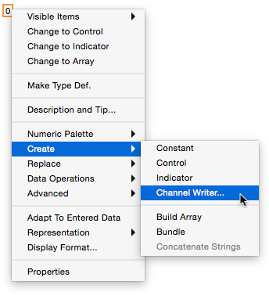
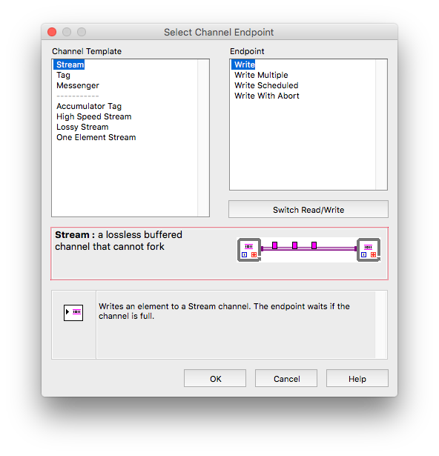
Create a Channel
Notes:
How do you create a channel?
*Popup on a terminal, select Create >> Channel Writer… to get a dialog box, select the kind of channel and the desired endpoint, click OK and the endpoint is dropped and wired up.
*The first time a particular kind of channel is created for a particular data type it will take a little time to script the instance.
*On the left of the dialog box, the principal channels: Stream, Tag, and Messenger, are at the top, and below are additional channels: Accumulator Tag, and 3 variations of Stream.
*On the right are the various endpoints available for the selected channel. They basically vary in the number of extra parameters available.
*At the bottom is an animation of the channel functionality and a brief description of the endpoint.

Slide 7
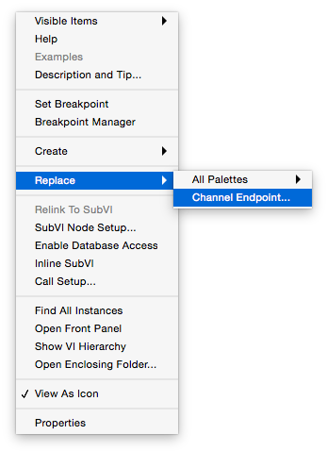
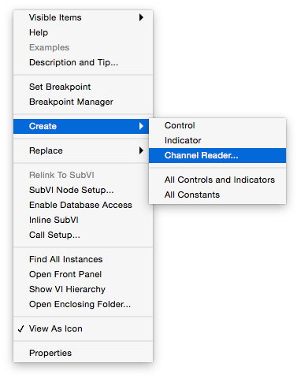
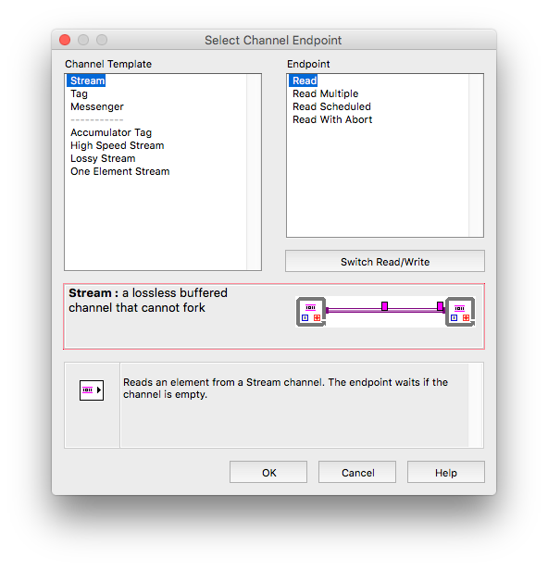
Create a Channel, cont’d
Notes:
Popup on the Channel output of the Write endpoint, select Create >> Channel Reader… to get a dialog box, select the desired read endpoint, *click OK and the read endpoint is dropped and wired up to the write endpoint.
*To change an endpoint popup on it, and select Replace >> Channel Endpoint… which leads to the same dialog box as before.

Slide 8
Stream Channel Example
Notes:
Putting it all together, here’s an example of a Stream channel connecting a producer to a consumer.
*Starting with the random number strip chart as the producer loop, popup on the wire, select Create >> Channel Writer…, Stream and Write are already selected by default, click OK. Wire the Channel over to the consumer loop. Popup on it, select Create >> Channel Reader…, Stream and Read are already selected, click OK. Wire the read endpoint output to the second chart.
Wire the last element? input to the stop button in the producer loop. And wire the last element? output to the stop terminal in the consumer loop.
Run the VI to see the producer data streamed to the consumer, hit the stop button to see both loops stop.
A Stream Channel is like a queue or fifo. It has a single writer and a single reader.
The Last element “sideband communication” makes it easy to stop both loops without having to worry about race conditions or deadlocks.

Slide 9
Tag Channel Example
Notes:
Here is a scenario where there are three non-communicating loops, but you would like to stop them all with a single button. We can do that with a Tag Channel.
*Popup to create a Tag writer in the loop with the stop button. Wire the Tag Channel to the second loop, popup to create a Tag reader and wire it to the loop stop terminal. Make a copy of the reader for the third loop, connect it to the Tag Channel and wire it to the loop stop terminal.
Run the VI. When the stop button is clicked, True is written to the Tag and the first loop stops. The other loops will read the True value and also stop. In general, they have executed different numbers of iterations because they weren’t synchronized in any way.
A Tag is like a global whose scope is limited to the endpoints connected to the Channel. A Tag can have multiple readers and multiple writers connected.

Slide 10
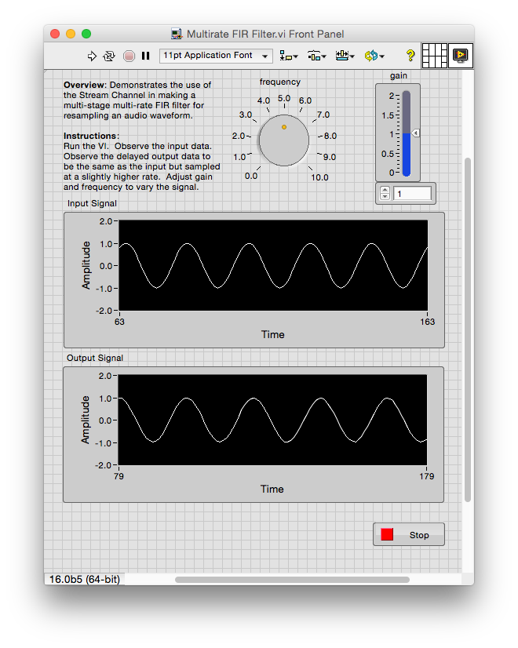
Multi-stage Multi-rate FIR Filter
4 subVI instances & 2 loops
all execute in parallel
filter stage
normal re-entrant subVI
Notes:
Here’s a more interesting example using Stream Channels: a multi-stage multi-rate FIR filter for resampling an audio waveform. The 4 filter stages and Both while loops and 4 instances of the reentrant FIR filter stage subVI all run in parallel.
Each filter stage is a loop which reads from its input Stream and writes to its output Stream. The number of samples output can differ from the number of samples input, so that filter stages can run at different rates. E.g., the leftmost stage interpolates by 2: it produces two outputs for each input. The next stage decimates by 3 and interpolates by 2.
Coefficients, interpolation and decimation factors are normal inputs passed to the filter stage subVI when it is called. Inside the subVI is a while loop that runs continuously, inputting values from one Stream and outputting values to the other Stream, and finishes when it detects the last data element.

Slide 11
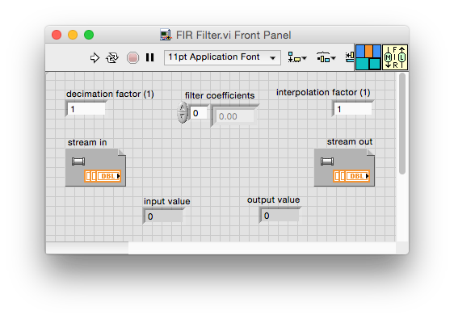
FIR Filter
read 0 or more samples
per while loop iteration
write one sample
per while loop iteration
Notes:
Here’s the filter subVI. The left side of the diagram rearranges coefficients for computational efficiency.
The right side is the filter loop. Each iteration of while loop produces a single output value, while reading zero or more input values via the for loop.

Slide 12
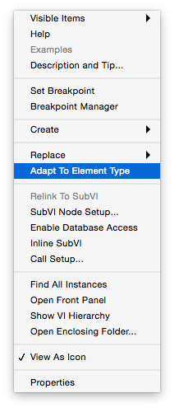
Other Popup Items
Notes:
If you already have a Channel and change the element type *the Channel remains the original type. *Popup on the write endpoint and select Adapt To Element Type. *It’s a short cut for replacing the endpoint with itself, which causes it to use the new type.
Now the channel is broken because the writer is writing one type and the reader is expecting another. *Popup on the read endpoint and select Adapt To Channel Type. *Now the output of the reader matches the type of the input to the writer. Change the indicator to complete the process.

Slide 13
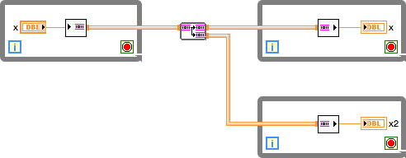
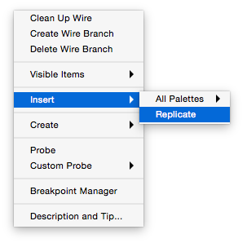
Replicate A Stream
Notes:
A Stream connects a single writer to a single reader. But sometimes it is necessary to have a producer send the same data to two consumers that may consume it at different rates.
*Popup on the channel and insert a Replicate node.
The *Replicate node is just a subVI with a loop that reads from the input stream and writes each value to both output streams. It ends when it sees the last data element.
The second stream output can be connected to a second consumer’s read endpoint.

Slide 14
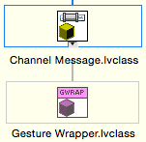
Messenger
Notes:
The Messenger Channel is the third principle kind of communication channel. It is similar to a Stream in that the writer enqueues messages and the reader dequeues them. But it also supports multiple writers and multiple readers.
*In this example the 100 Hz loop at left monitors the mouse position and button state. Whenever a gesture is detected (e.g., mouse-down, mouse-moved, mouse-up) it is written to the Messenger Write Endpoint.
The 10 Hz loop on the right renders the scene in a picture control. Whenever a gesture is available from the Messenger it processes it by moving the position of the square if necessary.
*The Messenger transports objects which inherit from the Channel Message class so the Gesture Wrapper class was created to contain a Gesture and inherit from Channel Message. Being class-based the Messenger Channel can implement some interesting capabilities such as Merge. In this example multiple mouse-moved gestures are merged to keep the Messenger Channel from filling up.

Slide 15
Channel Probe
Notes:
Channels can be probed. *When the VI is running click the probe tool on the channel. A probe VI opens to show the status of the channel.
Clicking the Pause button will stop the Channel at the next operation of any endpoint. Clicking the single-step button will continue and then stop at the next endpoint operation. Clicking the play button will resume normal operation of the channel.
When the stop button is clicked you can see the last element written flag get set.

Slide 16
Stream Channel Endpoints
Write
Read
Write Multiple
Read Multiple
Write Scheduled
Read Scheduled
Write With Abort
Read With Abort
Notes:
Endpoint details. Write and Read are the simplest endpoints to use.
*Most endpoints have a timeout input which defaults to -1 meaning wait as long as necessary for the operation to complete.
*The count output indicates how many data elements are in the channel buffer after the write or read operation completed.
*The size input specifies the maximum number of data elements the stream can buffer. It defaults to unlimited, which means the write endpoint will never block or timeout— the stream will just be expanded to hold the new data element, if necessary. Size is only used on the first call.
*Last element? indicates the channel is closing; element valid? is normally true but could be false if the channel is closed without writing a last value.
The Write Multiple and Read Multiple endpoints are similar to the basic ones except they write and read an array of data elements.
The Write Scheduled and Read Scheduled endpoints will attempt the operation at a scheduled time and return the actual time at which it occurred. These endpoints are anticipating future timing functionality which is still in research.
The Write With Abort and Read With Abort endpoints add another “sideband communication”. If abort is true for one endpoint, aborted? will be true for the other. This is a way to stop the channel from either endpoint.

Slide 17
Tag Channel Endpoints
Write
Read
Write Scheduled
Read Scheduled
Write With Abort
Read With Abort
Notes:
Write and Read are the simplest endpoints to use.
*Previous element is the value that was just overwritten by the new value.
*Timeout defaults to 0 meaning return immediately with the current Tag data. A non-zero value means wait until Tag data is available which is newer than the last one read.
*Missed is -1 if the element just read is the same one read on the previous call. It is 0 if the element just read is a new one and none were missed. It is a number >0 if the element just read is a new one, but that number of Tag elements were overwritten and missed by this reader.

Slide 18
Messenger Channel Endpoints
Write
Read
Write Scheduled
Read Scheduled
Write With Abort
Read With Abort
Write Ack
Read Ack
Read Ack With Abort
Notes:
Write and Read are the simplest endpoints to use.
*Element is typically an object that inherits from the Channel Message base class. If it is some other data type a Wrapper class will be automatically created internally, but none of the extra capabilities will be implemented (Merge, Dispose).
*Timeout and size work the same as for a Stream channel.
*If the wait for ack input is true the write endpoint will not complete until the message is acknowledged by a reader.
*The id output is a unique message number (>0) which can be used to wait for an acknowledgement at a later time (using a Read Ack endpoint).
*The ack id input can be used to acknowledge a previous message while reading a new one.

Slide 19
Messenger Ack Usage
Write and Read, no ack
Write and wait for ack
Read and ack last message
Write and wait for ack later
Read and ack sooner
Use of ack can be message dependent
Notes:
Acknowledge is a feature of the Messenger channel which can enable some synchronization between writer and reader.
Here’s the simple case that doesn’t use ack.
*In this case the writer doesn’t finish until the message is acknowledged by the reader. On the read side the unique id is pulled from the message and supplied to the read endpoint on the next iteration to acknowledge the prior message.
*The ack can be broken out of the endpoint. Here the writer can do some processing before waiting for the ack. It could even save up message ids and wait for acks much later. The reader can get the id and acknowledge the message sooner than the next loop iteration if desired.
*The use of acknowledge capability is optional and can be message dependent. However, it is up to the user to make sure that messages requiring an acknowledgement are actually acknowledged at some point.

Slide 20
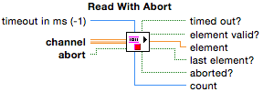
Stream Abort Usage
normal stop
abort from consumer
abort from producer
error abort from consumer
Notes:
Here is a Producer-Consumer Stream example showing how abort can be used.
*The normal behavior is to stop the Stream with the last element? input on the write endpoint of the producer. When the consumer catches up, the read endpoint will return last element? True and that is the signal to exit the consumer loop.
*If an emergency occurs on the producer side, the abort input of the write endpoint is set to True. The write will complete immediately and the aborted? output will be True, indicating that the producer loop should stop. The consumer will also see the aborted? output right away, without having to catch up, and that is its signal to exit the loop.
*If an emergency occurs on the consumer side, the abort input of the read endpoint is set to True. The read will complete immediately and the aborted? output will be True, indicating that the consumer loop should stop. The producer will also see the aborted? output right away and that is its signal to exit the loop.
*If the consumer detects an error after the read, it can set the abort input on the next iteration by using a shift register. The aborted? outputs of both endpoints will be True meaning both loops should exit.
*Caveats regarding abort: if the Stream is full and the write endpoint is blocked, the producer will not process the Abort Producer button until the write completes. A similar problem exists on the consumer side.
For the High Speed Stream, the abort behavior is the same but the implementation is different.

Slide 21
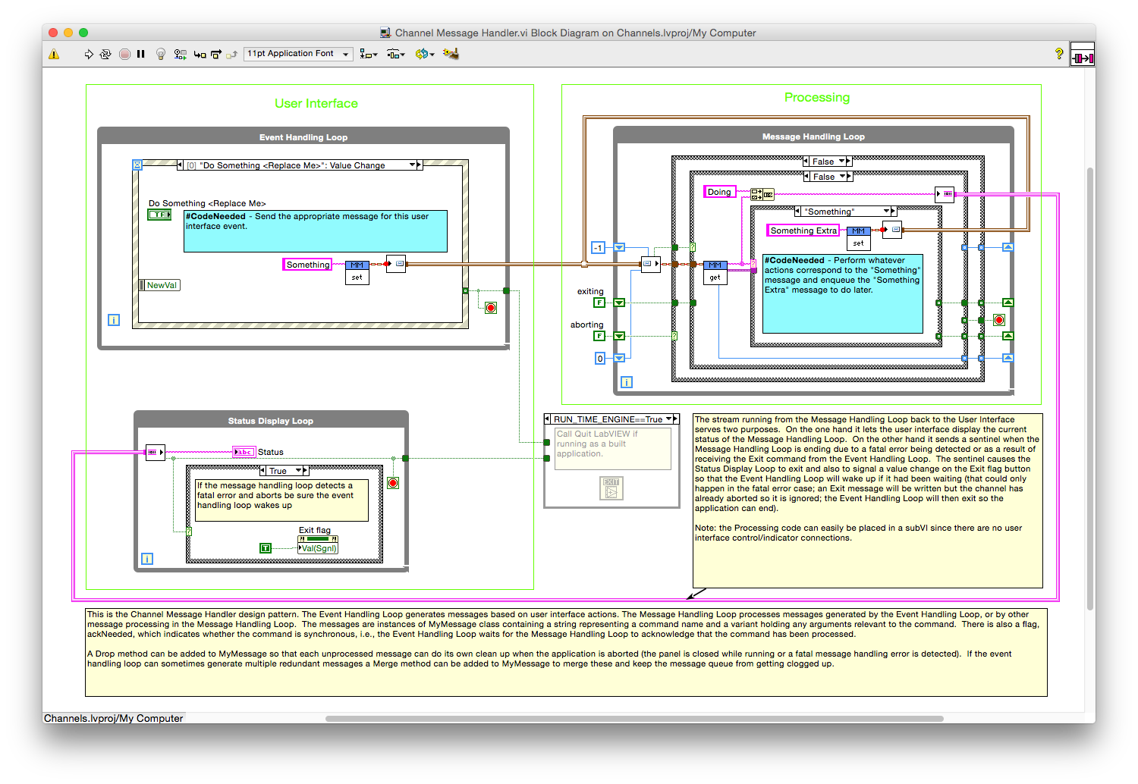
Channel Message Handler
Notes:
In the examples folder is a channel example patterned after the queued message handler template.
*The left side shows the User Interface portion, with the top loop responding to events and the bottom loop displaying status.
*The right side shows the main activity loop. It receives commands from the event loop via the Messenger channel, and sends status information to the display loop via the string Stream channel.

Slide 22
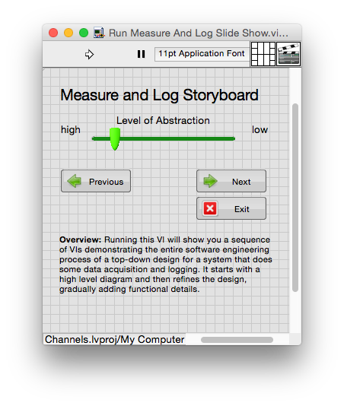
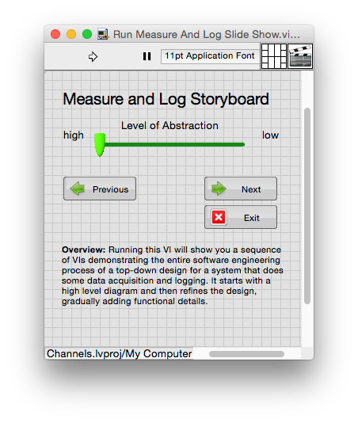
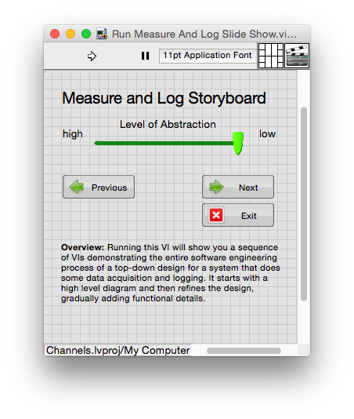
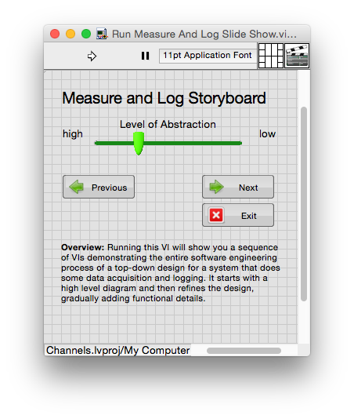
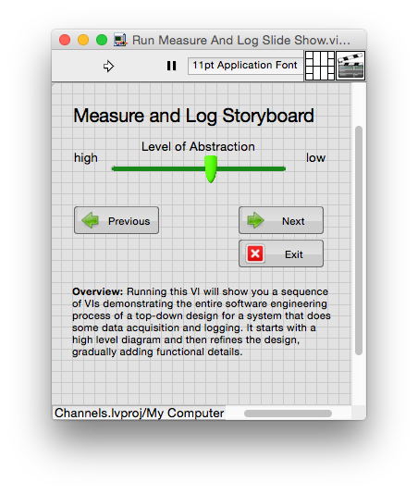
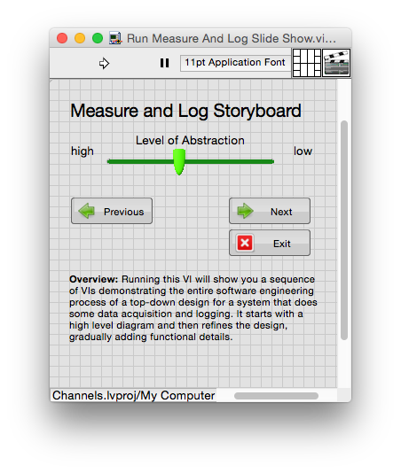
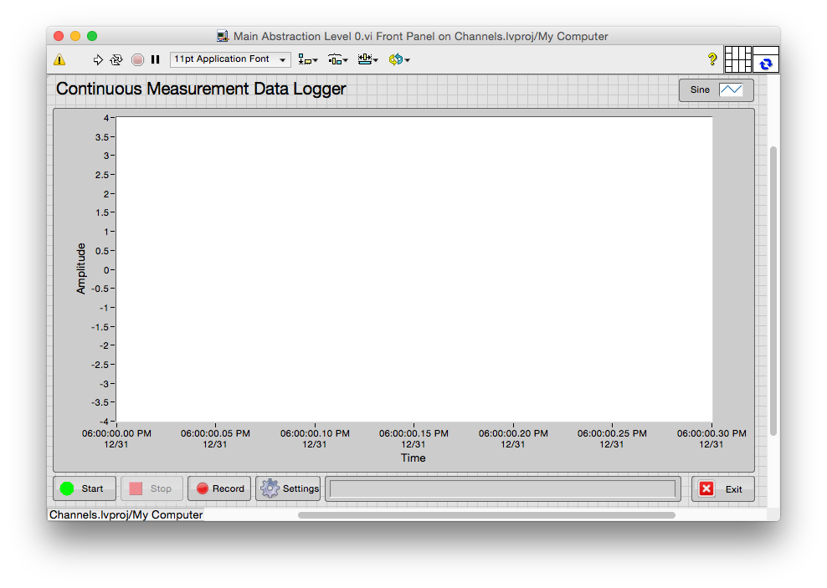
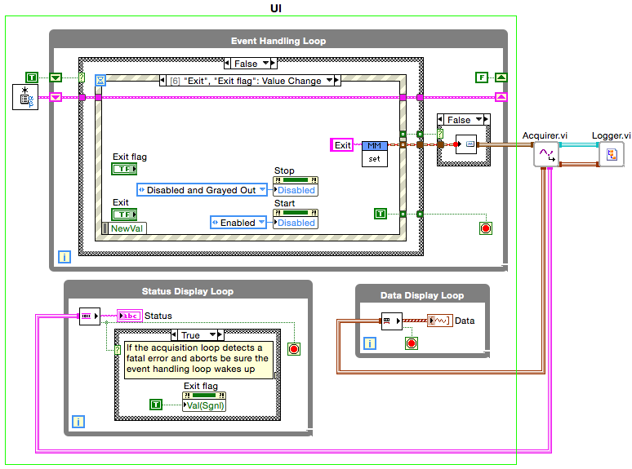
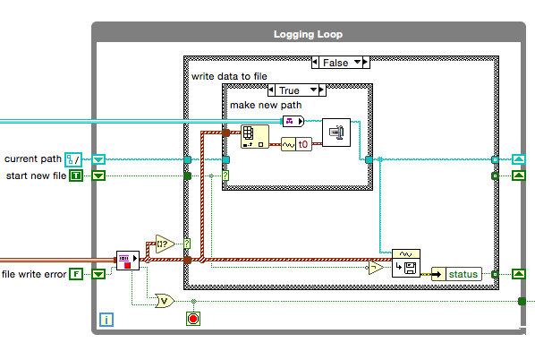
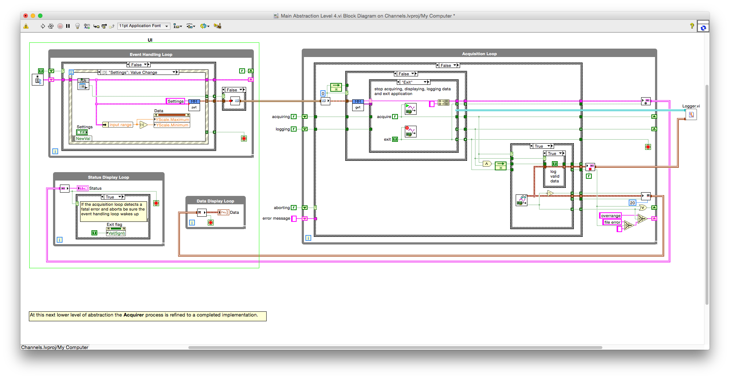
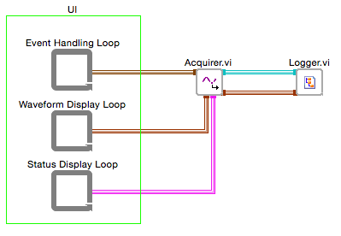
Measure And Log
panel
top-3 level abstraction
top-4 level abstraction
bottom level abstraction
UI behavior
top-2 level
abstraction
top level
abstraction
top-1 level
abstraction
Notes:
Also in the examples folder is a channel example for a simple DAQ application that measures and logs data. The DAQ portion is simulated so the app runs without any hardware. This is partly an example and partly a vision for the future of LabVIEW development.
Run the slide show VI to see a series of VIs, starting with a high-level abstraction and refining to a working application. At the top-level the panel is created and the abstract processes are identified.
*The next level refines the communication between the abstract processes.
*The next level refines the UI behavior and decomposes the UI process into three loops, one to handle events, one to display status, and one to display acquired data.
*The next level implements the UI behavior using an event loop.
*The next level refines the Acquisition loop.
*The bottom level refines the Logging loop.

Slide 23
Questions?
Notes:
Answers.

Slide 24
FAQs
How can I tell what’s a Channel and what’s a regular wire?
Subtle diffs: asymmetric coloring, invisible tunnels, flanges at subVIs.
Won’t Channels make diagrams too confusing?
Actually, less confusing because fewer references are needed.
Aren’t Channels changing data flow as we all learned it?
They augment existing (synchronous) data flow with asynchronous flow.
I know how to use the built-in queue; isn’t it sufficient?
Yes. But Channels are easier to construct and see the communications.
Channels are for beginners; why should I care about them?
They make it easier to do what is already possible. Probes help debug!
Can I hide Channels, or all wires except Channels?
Not yet. This is a subset of being able to show levels of abstraction.
Notes:
We experimented with more in-your-face graphics but it quickly seemed obnoxious. Once you’re familiar with channels, subtle is better.
Channels extend G’s syntax and simplify the application because fewer references (and their spooky action-at-a-distance) are needed. As with any innovation, some learning is necessary. But not nearly as much as is needed for references. I’m confident all can learn, just as we have learned to tell the difference between electric wires, water pipes, and natural gas lines in our homes.
Channels augment existing data flow with an asynchronous data flow. It is still data flow, still by-value, much easier to reason about than any alternatives, and much easier to make correctly working applications.
Built-in queues and globals are sufficient but the artificial complexity of using them is higher than for using Channels. Of course, queues and globals aren’t going away so if you prefer to stick with them that’s your call.
Channels don’t have any fundamentally new capability (other than the ability to probe) but they automatically deal with initialization, synchronization, shut down, abort, and clean up issues that would otherwise consume a lot of design time. Built-in sidebands (e.g., last element, abort, ack) are much simpler & safer to use than re-inventing them each time you need them.
It would be great to be able to hide different items (error handling, special cases, etc.) and see an application at a higher level of abstraction but the general case is challenging and remains an area of research for now.

Slide 25
FAQs
Can Channels be used in a built application?
Yes.
What are the performance impacts of Channels?
Channels are implemented using subVIs with very efficient algorithms.
Can I bundle Channels together?
Channels are not data and cannot be put in data containers.
What happens if two nodes are connected by both a wire and a Channel?
Wire means sequential, Channel implies parallel. Likely to deadlock.
When do I use a Tag versus a Stream?
Depends. Use a Tag instead of a global, a Stream instead of a queue.
What is the biggest drawback of Channels?
Easier to tackle more complex apps, but communication is hard.
Notes:
Yes. They can be used within a DLL or packed library but not as part of the interface to a DLL or packed library.
The subVIs implementing Channels have efficient in-place algorithms to minimize overhead. The High Speed Stream (and Real Time Stream) have the highest performance but lack some of the other capabilities.
Channels are not data and cannot be connected to a bundle node or array build node. Grouping Channels to reduce clutter might still be desirable and that’s an ongoing research topic.
A wire says one node executes after the other. A Channel implies they execute in parallel. Not a good idea to do this— it will probably deadlock. Ultimately, the editor should provide a warning to help, and that’s a research topic as well.
Depends on your needs. Use a Tag where you would have used a global, and a Stream where you would have used a queue.
Because Channels make it easier to construct applications with communicating parallel components you will tackle more complex projects. Ensuring these apps work as expected without race conditions and deadlock is inherently complex. Channels help you get to the point of dealing with the inherent complexity much more quickly.

Slide 26
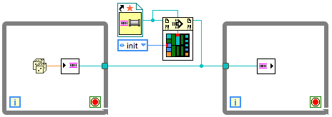
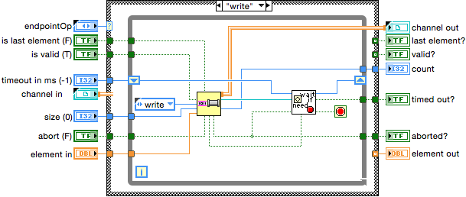
Channel Implementation Details
…resource/Channels/Stream/
channel
direction
Stream.lvlib
Write Endpoints
Read Endpoints
)Channel.vi
support VIs
)Channel.ctl
Element.ctl
…LabVIEW Data/2016(64-bit)/ExtraVILib/ChannelInstances/Stream-dbl/
Stream-dbl.lvlib
Notes:
A Channel is recognized as such by being a typedef with an unusual naming convention (cheap and easy to do for now).
*During type propagation the top-most channel segment is detected.
*A compile transform reverses the direction of channel outputs, and inserts a static VI reference at the top-most segment. The wire becomes a VI reference passed into all the endpoints so they call a common instance of the re-entrant channel implementation VI.
*After the channel and endpoint are selected in the dialog box the particular template is copied to the cache and converted to the specific type.
*What appears to be a call to the implementation subVI in the endpoint is converted to a CallByRef by the compiler transform. The implementation is basically a functional global.

